Slide 1
Project Development Workflow
Using Git, GitHub, and GitEye

Slide 2
Best Practices
Remote branch should never be broken
Always have full confidence that deployment to the remote won’t cause trouble
Develop features and bug fixes in (local) side branches
Try to reduce / avoid simultaneous editing
Careful task assignment
Frequent team communication

Slide 3
Your View of the Project
v 3.0
v 2.0
v 1.0
initial
abc01
master
origin/master
stable

Slide 4
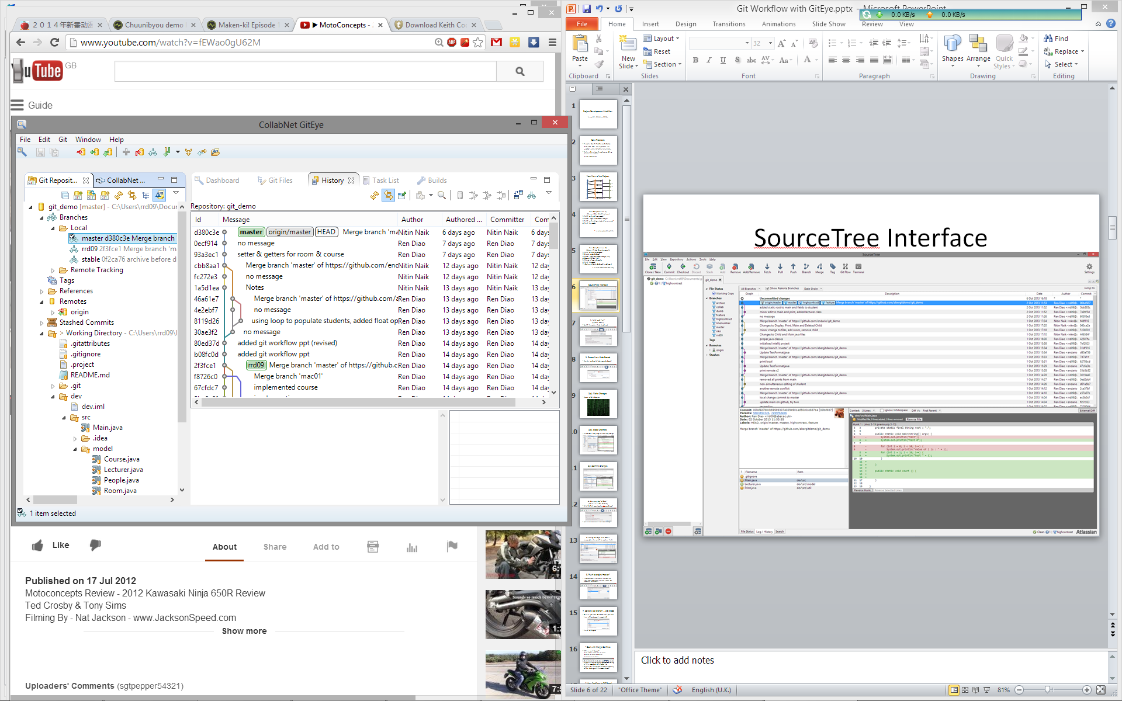
GitEye Interface

Slide 5
Your Daily Routine (1) (for Minor/Safe Modifications)
Fetch and pull from remote
Make changes
Stage, commit and push changes
Deal with updates/conflicts (when necessary)
master
origin/master

Slide 6
1. Fetch and Pull* (update master)
Switch to master (if not already on) and pull

Slide 7
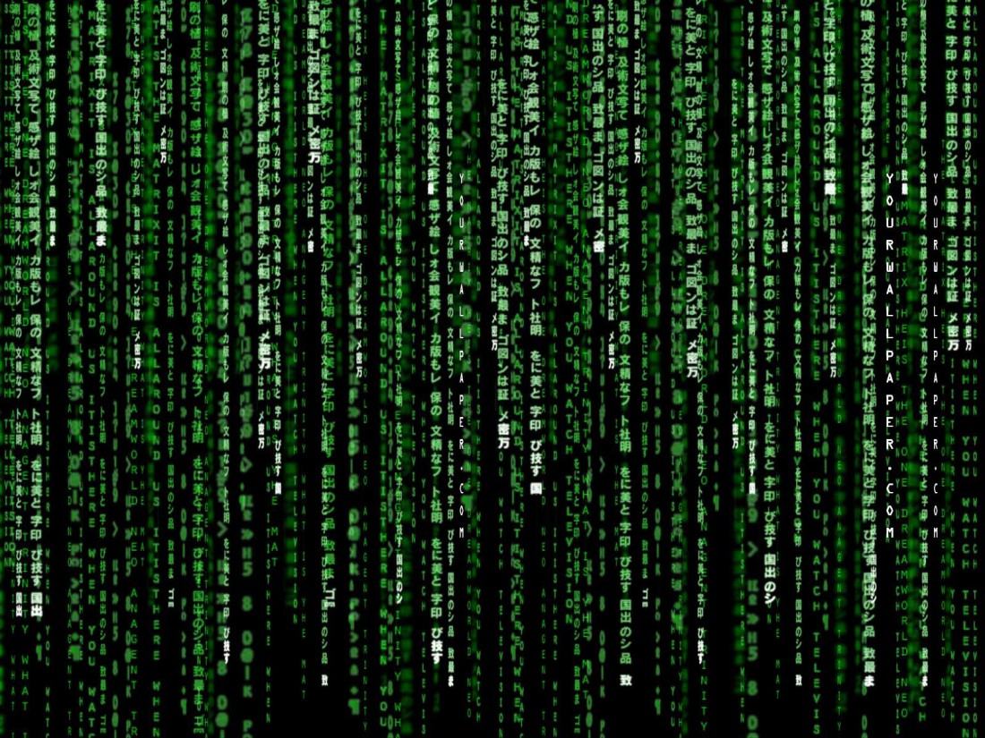
2. Make Changes
None of Git’s business

Slide 8
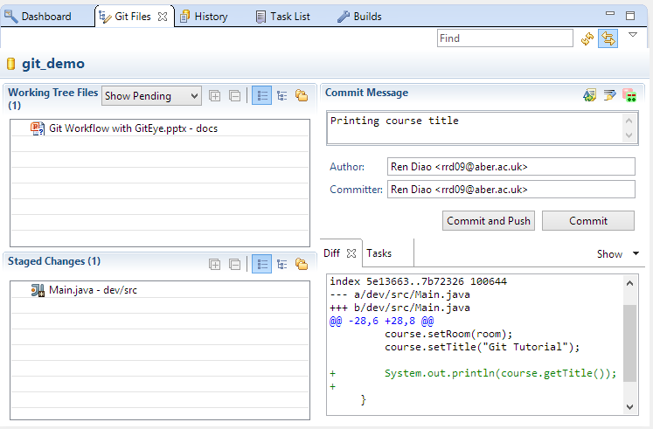
3(a). Stage Changes
Remember only stage the necessary changes

Slide 9
3(b).Commit and Push Changes

Slide 10
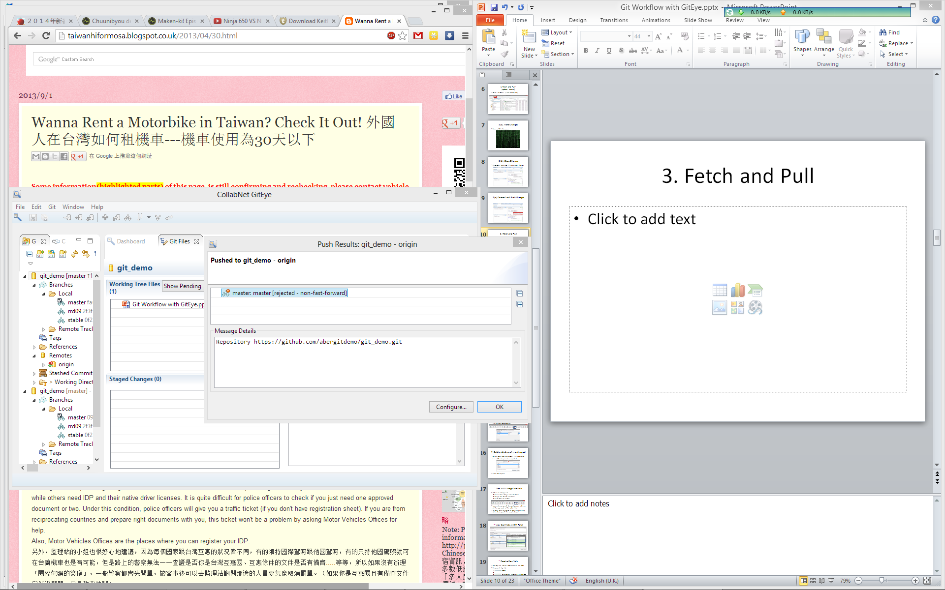
•(a). Deal with Updates/Conflicts
You may get an error like this:
Some team member may have updated the remote branch while you’re working

Slide 11
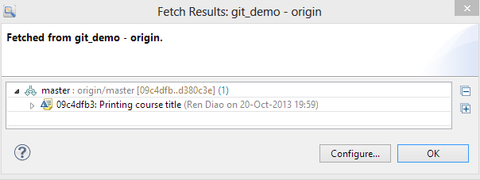
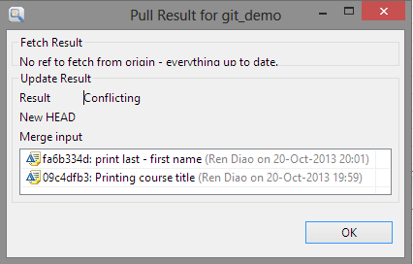
•(b). Deal with Updates/Conflicts
Fetch and pull updates
Sometimes you may get conflicts!

Slide 12
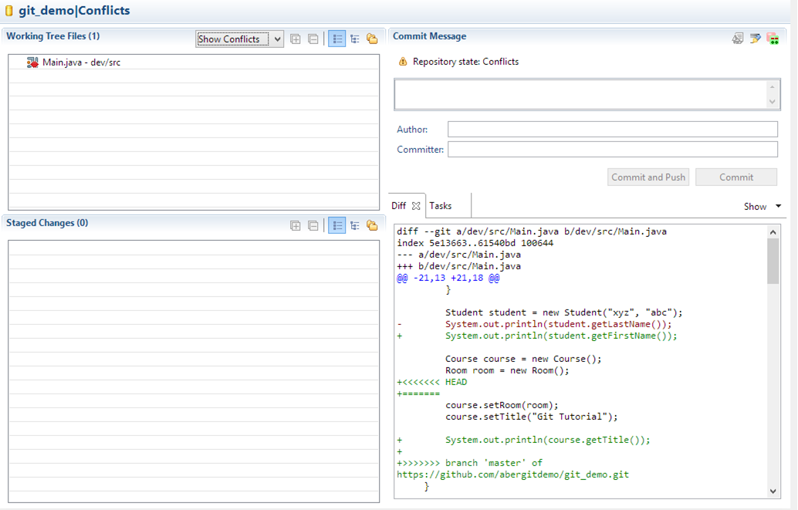
•(c). Deal with Updates/Conflicts
Make the necessary changes to restore consistency
Make sure it compiles and runs!
Stage the file again

Slide 13
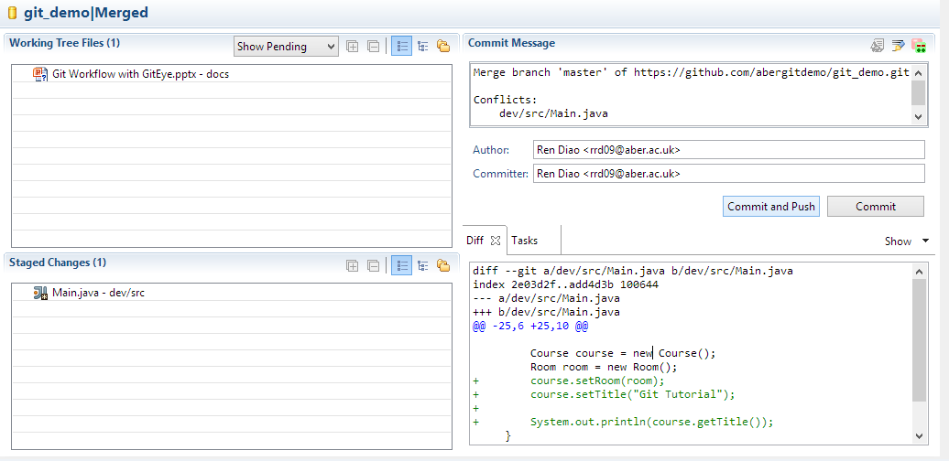
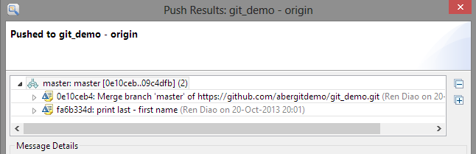
•(d). Deal with Updates/Conflicts
Finally, commit and push again (notice you pushed 2(+) commits)

Slide 14
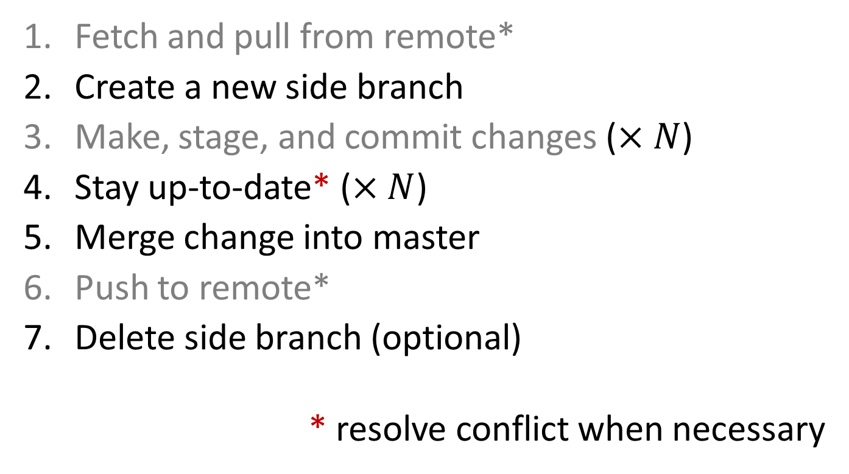
Your Daily Routine (2) (for Major/Risky Developments)
Fetch and pull from remote*
Create a new side branch
Make, stage, and commit changes ($×N$)
Stay up-to-date* ($×N$)
Merge change into master
Push to remote*
Delete side branch (optional)
* resolve conflict when necessary

Slide 15
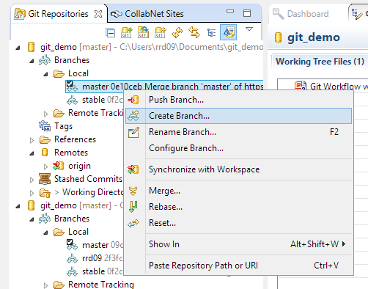
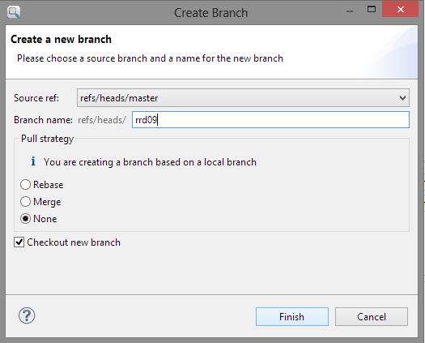
2. Create a New Side Branch
Create (and switch to) a new side branch

Slide 16
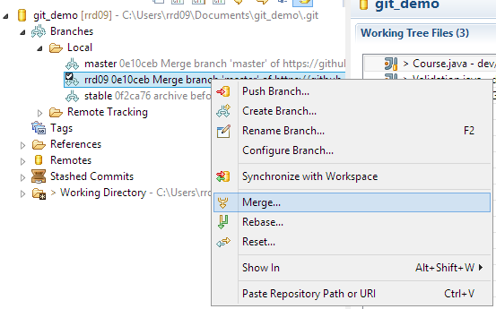
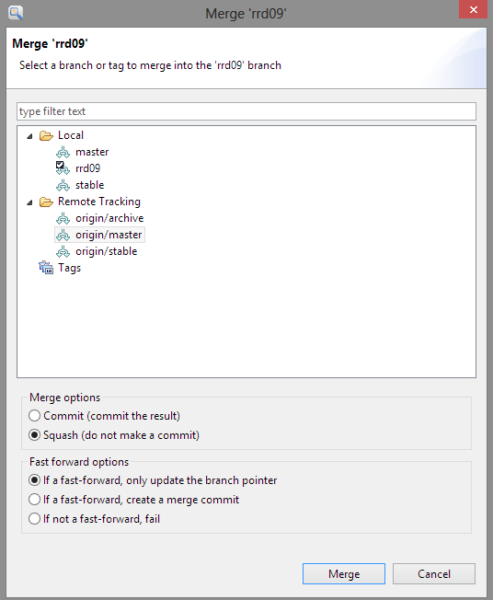
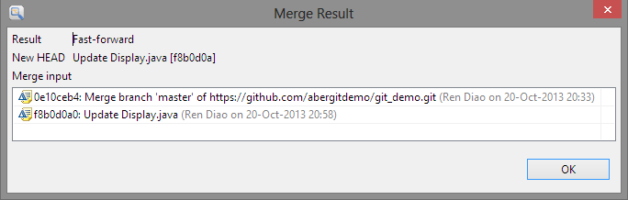
4. Stay Up-to-Date* (while in a side branch)
Fetch & Pull origin/master into your branch
and resolve any conflicts ...

Slide 17
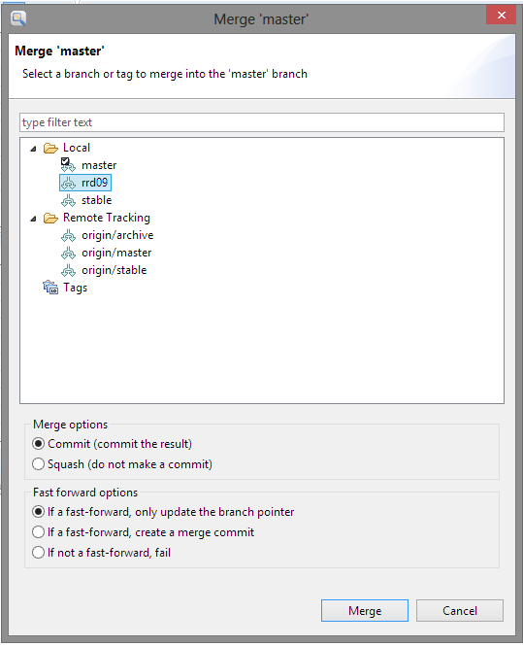
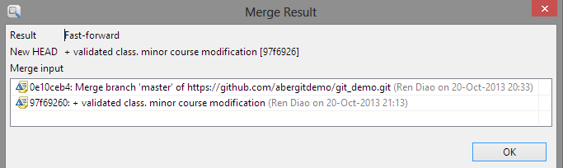
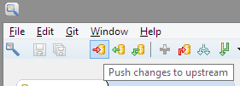
5. Merge Change into master (remember to switch to master first)
6. and push to remote
If someone updated remote master in the meantime, you need to Pull and deal with the potential merge conflicts

Slide 18
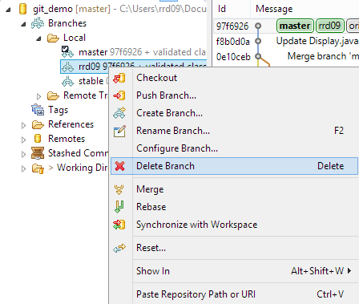
7. Delete side branch
Delete your local side branch if this particular line of development is completed
Make sure all changes have been merged

Slide 19
Merge Conflicts – A Revisit
When can it happen?
Pull remote changes into side branch
Merge side branch into master
Push master to remote
Inconsistency caused by simultaneous editing of the same part of the code / file
Try your best to resolve all conflicts, especially when dealing with the remote branch
Remember to stage the file again afterwards

Slide 20
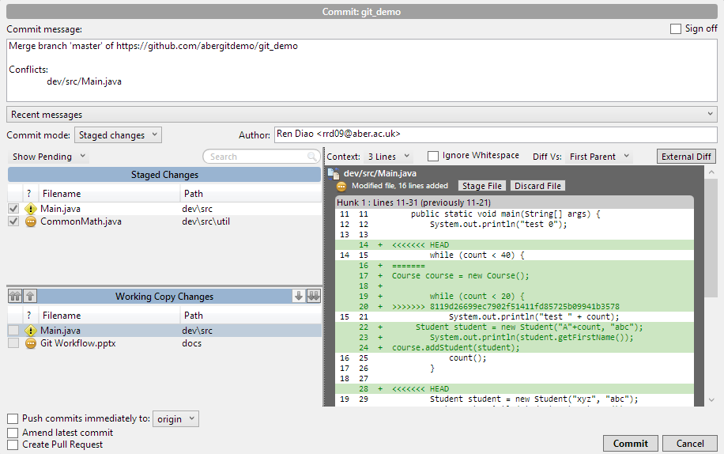
* View Conflicts in Diff Panel

Slide 21
* Resolve Conflicts
Use any text editor / IDE to correct the code
Remove all tags like
<<<<<<< HEAD
=======
>>>>>>> 8119d26699ec7902f51411fd85725b099
Make sure it compiles and runs
and/or logically correct!

Slide 22
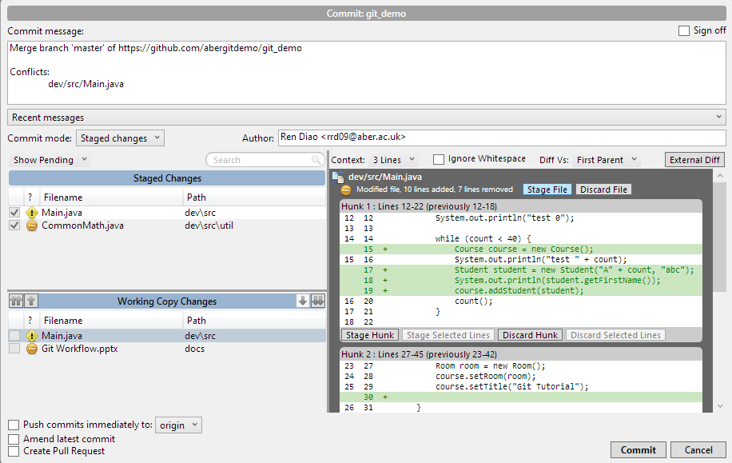
* Re-Stage and Commit

